Slide 1
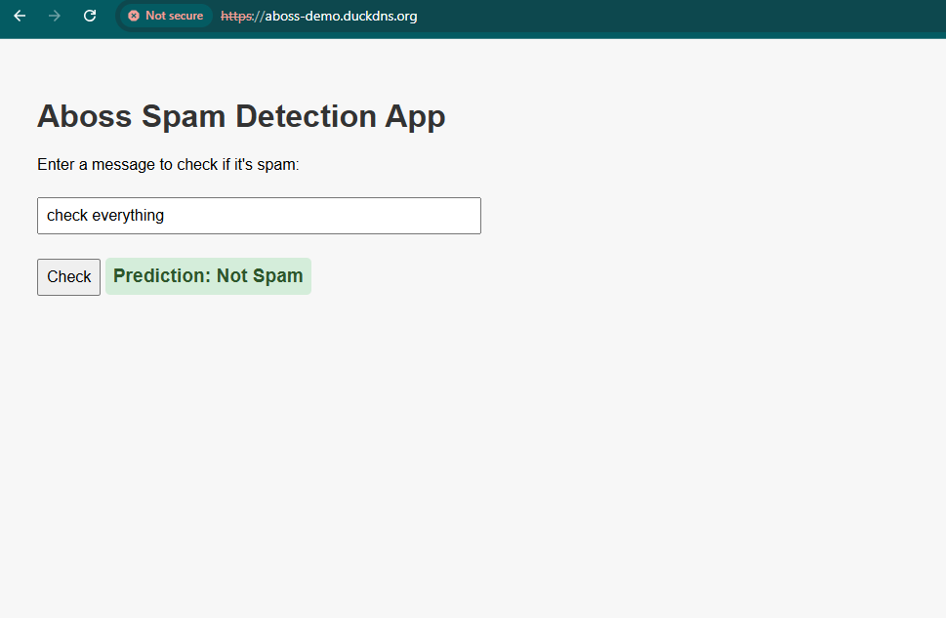
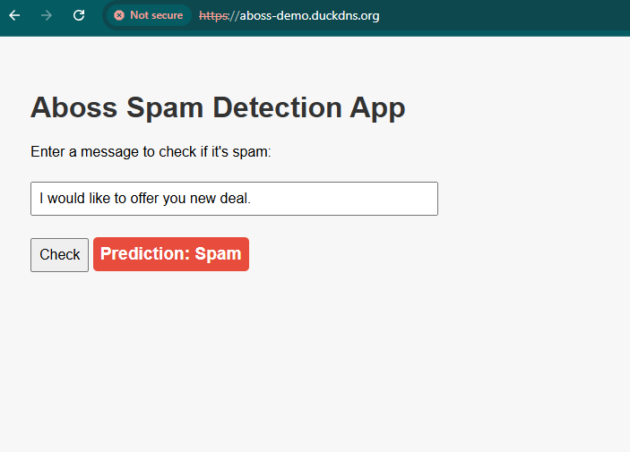
Introduction
Detect text having spam words included in the message.

Slide 2
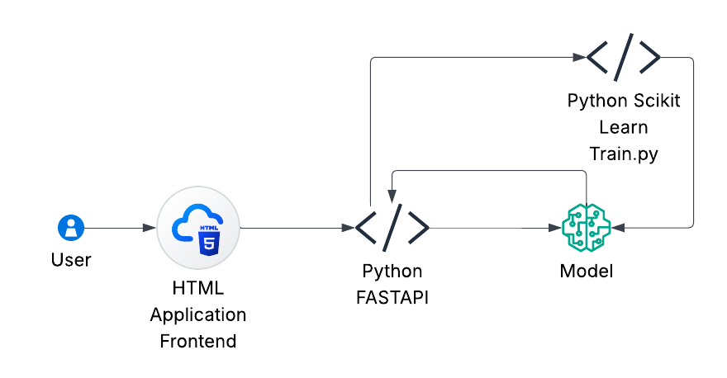
Programming
Using Python, Scikit Learn, the train application is created.
With the help of FastAPI, the prediction models stored are utilized.

Slide 3
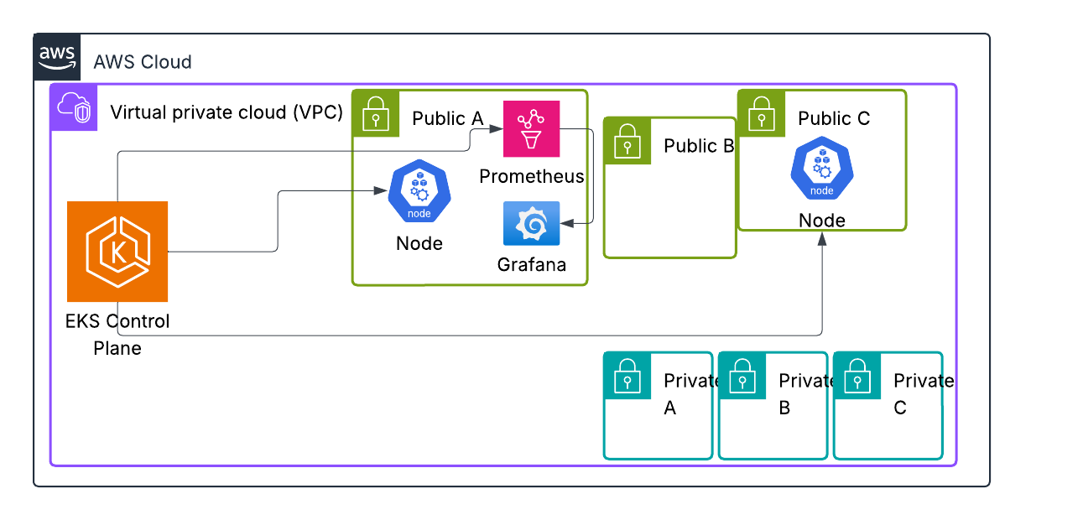
AWS Architecture Used for Deployment

Slide 4
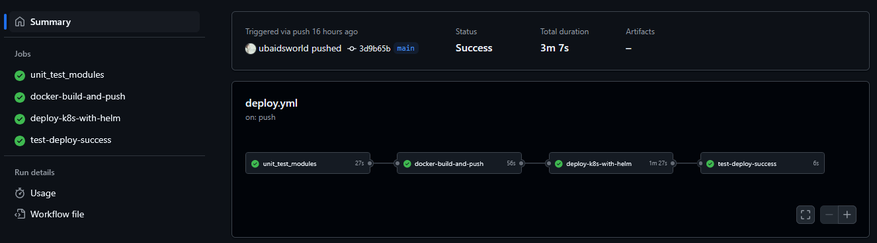
Github Actions CICD
Divided the CICD process into 4 stages viz:
unit_test_module: It verifies the python files utilized in this repository are tested and works accordingly
Docker-build-and-push: Generated docker file for the program using the Dockerfile and pushes it on the Dockerhub registry.
Deploy-k8s-with-helm: Using Helm automated the deployment, service, ingresss and certificate issuer configurations on EKS.
Test-deploy-success: Checks if the URL is up and working as expected.

Slide 5
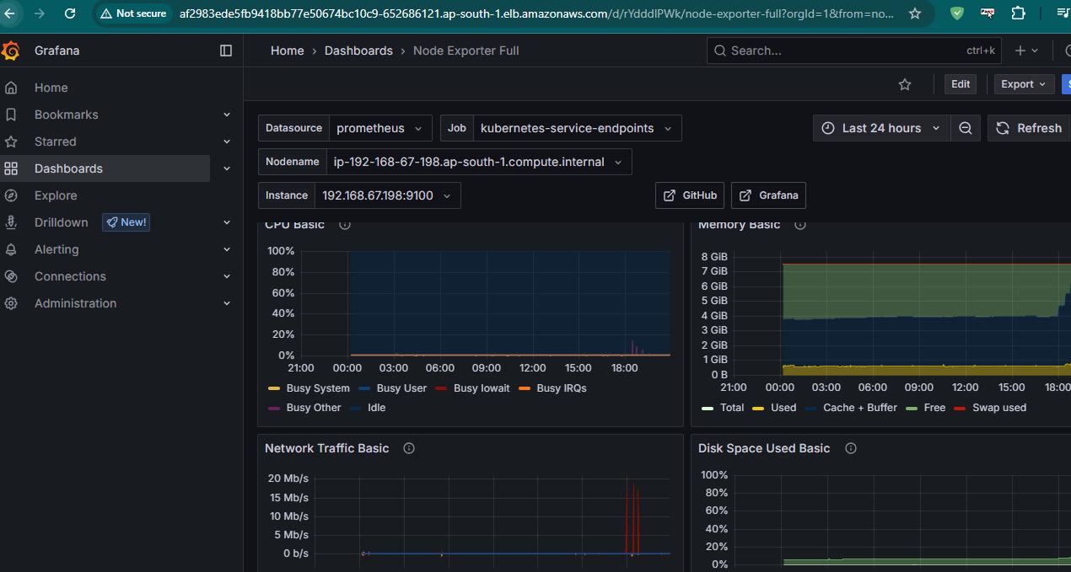
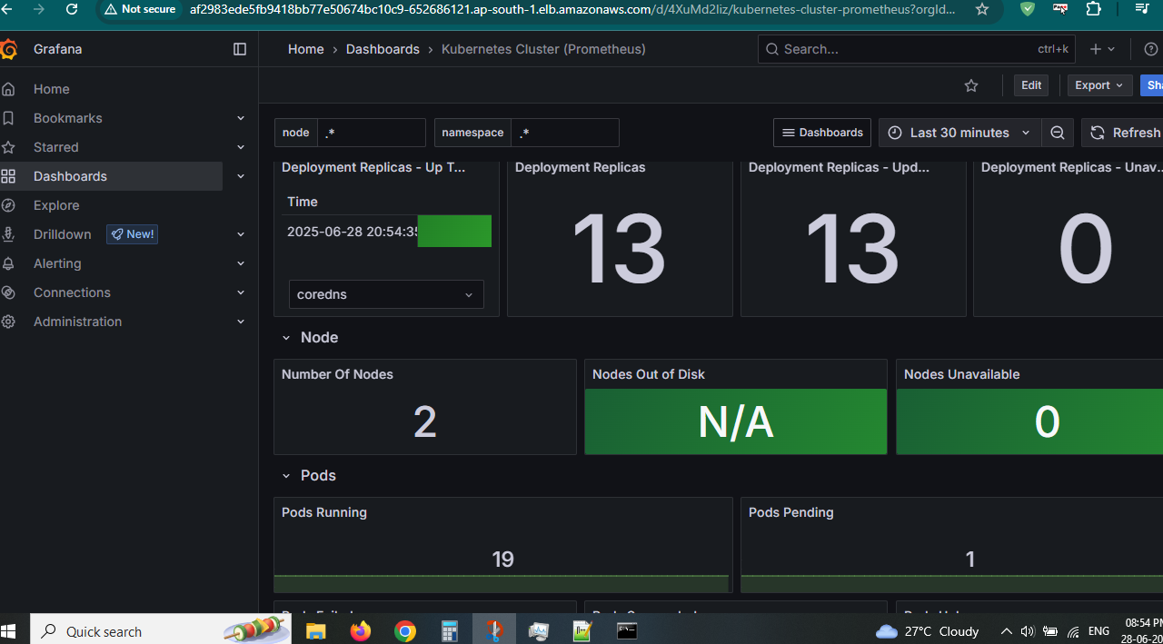
Observability

Slide 6
Disaster Recovery
If any pod stops working because of any issue like ImagePullBackOff
Then Check that the nodes have internet access
Or Check the name if the correct image is placed. Use on local to check the image using docker pull image:tag
Recovery Strategy:
Use liveness/readiness probes to auto-restart pods.
Rollback using kubectl rollout undo deployment/my-app
Re-deploy from CI/CD pipeline (GitHub Actions, ArgoCD)
Use Horizontal Pod Autoscaler to scale under load
On Node failure:
Recovery Strategy:
1. EKS auto-replaces unhealthy nodes
2. Re-scheduling of pods across available nodes
3. Use multiple AZs in managed node groups.

